Slide 1
fields

Slide 2
Baseline Model (Mean) MSE: 1.3919676380376185
Linear Regression Train MSE: 0.7370988688398005
Linear Regression Test MSE: 0.7802050017994422
Lasso Regression a=0.01 Train MSE: 1.1437895723173315
Lasso Regression a=0.01 Test MSE: 1.1606892442439827
Ridge Regression a=100 Train MSE: 0.77346759656303
Ridge Regression a=100 Test MSE: 0.7966494787142905
XGB Train MSE: 0.5844524900274015
XGB Test MSE: 0.6872410673901798
MLP Train MSE: 0.3751261068033116
MLP Test MSE: 0.6079936238097802
--- End Script ---
--- 242.07950520515442 seconds ---
Tfidf 1000
Baseline Model (Mean) MSE: 1.3919676380376185
Linear Regression Train MSE: 0.6547337847576454
Linear Regression Test MSE: 0.7180327414378629
Lasso Regression a=0.01 Train MSE: 1.0356457015339269
Lasso Regression a=0.01 Test MSE: 1.0476653473061208
Ridge Regression a=100 Train MSE: 0.8255712419064617
Ridge Regression a=100 Test MSE: 0.8462225888318095
XGB Train MSE: 0.851617763428976
XGB Test MSE: 0.8759399042661787
MLP Train MSE: 0.5517685989559394
MLP Test MSE: 0.7317592732824688
--- End Script ---
--- 198.0698573589325 seconds ---
Word2vec - summary
--- Start Script ---
Test Size: 0.2
Dataset: amazon_reviews_50k.csv
Linear Regression Train MSE: 0.8222078406127639
Linear Regression Test MSE: 0.8511099994765718
Lasso Regression a=0.01 Train MSE: 1.1751582864044827
Lasso Regression a=0.01 Test MSE: 1.190451998203056
Ridge Regression a=100 Train MSE: 0.8574475212427702
Ridge Regression a=100 Test MSE: 0.8750669993981588
XGB Train MSE: 0.6543510937653023
XGB Test MSE: 0.754910799908774
MLP Train MSE: 0.49061446790779417
MLP Test MSE: 0.7290667780844083
--- End Script ---
--- 107.48594689369202 seconds ---

Slide 3
Word2vec+tfidf – summary+full_review
Test Size: 0.2
Dataset: amazon_reviews_50k.csv
XGB Train MSE: 0.3537407479820878
XGB Test MSE: 0.5698759047475488
MLP Train MSE: 0.27935610423296814
MLP Test MSE: 0.5281658216761824
0: learn: 1.1367769 test: 1.1264566 best: 1.1264566 (0) total: 465ms remaining: 7m 44s
100: learn: 0.7675306 test: 0.7928447 best: 0.7928447 (100) total: 33.1s remaining: 4m 55s
200: learn: 0.7019617 test: 0.7600350 best: 0.7600350 (200) total: 1m 6s remaining: 4m 22s
300: learn: 0.6601025 test: 0.7467850 best: 0.7467850 (300) total: 1m 36s remaining: 3m 43s
400: learn: 0.6280862 test: 0.7399078 best: 0.7399078 (400) total: 2m 4s remaining: 3m 5s
500: learn: 0.5992757 test: 0.7347669 best: 0.7347466 (499) total: 2m 32s remaining: 2m 31s
600: learn: 0.5738453 test: 0.7313882 best: 0.7313752 (599) total: 3m 8s remaining: 2m 5s
700: learn: 0.5511311 test: 0.7282763 best: 0.7282763 (700) total: 3m 49s remaining: 1m 38s
800: learn: 0.5313109 test: 0.7259545 best: 0.7259462 (799) total: 4m 32s remaining: 1m 7s
900: learn: 0.5122559 test: 0.7245656 best: 0.7245417 (898) total: 5m 10s remaining: 34.1s
999: learn: 0.4951404 test: 0.7225919 best: 0.7225919 (999) total: 5m 50s remaining: 0us
bestTest = 0.7225918925
bestIteration = 999
CatBoost Train MSE: 0.24516401057449858
CatBoost Test MSE: 0.5221390430977011
done
--- End Script ---
--- 1355.4370653629303 seconds ---
Word2vec+tfidf – summary+full_review
Test Size: 0.2
Dataset: amazon_reviews_5k.csv
XGB Train MSE: 0.06595972619886108
XGB Test MSE: 0.7392432695493184
MLP Train MSE: 0.356959664490996
MLP Test MSE: 0.8663254274488852
0: learn: 1.1308391 test: 1.1448352 best: 1.1448352 (0) total: 393ms remaining: 6m 32s
100: learn: 0.6452514 test: 0.8830004 best: 0.8830004 (100) total: 11.6s remaining: 1m 43s
200: learn: 0.4909148 test: 0.8708974 best: 0.8701262 (190) total: 23.2s remaining: 1m 32s
300: learn: 0.3874812 test: 0.8695210 best: 0.8691914 (296) total: 34.1s remaining: 1m 19s
400: learn: 0.3116858 test: 0.8679782 best: 0.8677940 (387) total: 46.1s remaining: 1m 8s
500: learn: 0.2587053 test: 0.8684713 best: 0.8672726 (444) total: 1m remaining: 59.8s
600: learn: 0.2192937 test: 0.8684492 best: 0.8670067 (549) total: 1m 13s remaining: 48.5s
700: learn: 0.1859822 test: 0.8687728 best: 0.8670067 (549) total: 1m 25s remaining: 36.6s
800: learn: 0.1570209 test: 0.8680299 best: 0.8670067 (549) total: 1m 38s remaining: 24.4s
900: learn: 0.1329547 test: 0.8670791 best: 0.8670067 (549) total: 1m 50s remaining: 12.1s
999: learn: 0.1147381 test: 0.8671190 best: 0.8669279 (986) total: 2m 1s remaining: 0us
bestTest = 0.8669278916
bestIteration = 986
Shrink model to first 987 iterations.
CatBoost Train MSE: 0.013606410016538395
CatBoost Test MSE: 0.751563969209689
done
--- End Script ---
--- 295.23813939094543 seconds ---

Slide 4
Baseline Model (Mean) MSE: 1.3752840001867597
Test Size: 0.2
Dataset: amazon_reviews.csv
MLP Train MSE: 0.27820755366929323
MLP Test MSE: 0.4050599173769314
0: learn: 1.1318937 test: 1.1350098 best: 1.1350098 (0) total: 1.89s remaining: 1h 3m
100: learn: 0.7798906 test: 0.7873007 best: 0.7873007 (100) total: 2m 5s remaining: 39m 13s
200: learn: 0.7443480 test: 0.7553333 best: 0.7553333 (200) total: 3m 50s remaining: 34m 26s
300: learn: 0.7234055 test: 0.7379113 best: 0.7379113 (300) total: 5m 40s remaining: 32m 2s
400: learn: 0.7082401 test: 0.7263429 best: 0.7263429 (400) total: 7m 29s remaining: 29m 51s
500: learn: 0.6961291 test: 0.7176581 best: 0.7176581 (500) total: 9m 19s remaining: 27m 54s
600: learn: 0.6861761 test: 0.7111238 best: 0.7111238 (600) total: 11m 7s remaining: 25m 54s
700: learn: 0.6772581 test: 0.7056367 best: 0.7056367 (700) total: 12m 56s remaining: 23m 58s
800: learn: 0.6694112 test: 0.7010474 best: 0.7010474 (800) total: 14m 43s remaining: 22m 2s
900: learn: 0.6622262 test: 0.6970844 best: 0.6970844 (900) total: 16m 30s remaining: 20m 8s
1000: learn: 0.6556632 test: 0.6937388 best: 0.6937388 (1000) total: 18m 17s remaining: 18m 15s
1100: learn: 0.6495016 test: 0.6907345 best: 0.6907345 (1100) total: 20m 3s remaining: 16m 23s
1200: learn: 0.6436104 test: 0.6879136 best: 0.6879136 (1200) total: 21m 53s remaining: 14m 33s
1300: learn: 0.6380483 test: 0.6854754 best: 0.6854754 (1300) total: 23m 40s remaining: 12m 42s
1400: learn: 0.6328136 test: 0.6832873 best: 0.6832873 (1400) total: 25m 27s remaining: 10m 53s
1500: learn: 0.6277444 test: 0.6811695 best: 0.6811695 (1500) total: 27m 15s remaining: 9m 3s
1600: learn: 0.6227442 test: 0.6791963 best: 0.6791963 (1600) total: 29m 3s remaining: 7m 14s
1700: learn: 0.6180380 test: 0.6773836 best: 0.6773836 (1700) total: 30m 46s remaining: 5m 24s
1800: learn: 0.6134844 test: 0.6757142 best: 0.6757142 (1800) total: 32m 38s remaining: 3m 36s
1900: learn: 0.6091299 test: 0.6741634 best: 0.6741634 (1900) total: 34m 26s remaining: 1m 47s
1999: learn: 0.6050002 test: 0.6727476 best: 0.6727476 (1999) total: 36m 10s remaining: 0us
bestTest = 0.6727476214
bestIteration = 1999
CatBoost Train MSE: 0.3660252844867509
CatBoost Test MSE: 0.4525893620825757
--- End Script ---
--- 12847.845738172531 seconds ---

Slide 5
Data preperation
Remove “unnamed” columns – likely caused by extra commas and were deleted.
Fill missing values

Slide 6
Strategy for Model Development
Given your goal, the model should be trained on features that would realistically be available prior to user interactions. Here's how to adjust your strategy: Exclude reviewText and summary: Since these fields are not in line with the predictive goal, they should be excluded from your feature set for this particular model.
Temporal and Verification Features: If you have fields like verified and temporal data related to the product listing (not the review), they might still be relevant. For example, verified might indicate if the product typically sells as a verified item on the platform, which could influence its perceived trustworthiness or quality. Feature Engineering and Selection: Continue with feature engineering for the pre-purchase attributes.
For textual data, NLP techniques like TF-IDF or embeddings for itemName, description, and feature columns are appropriate. For numerical data like price, ensure it's properly scaled. Categorical data, such as brand or category, can be encoded suitably. Model Training: Train your model on this adjusted feature set, targeting the rating as the output variable.

Slide 7
Data preperation I
Next Steps for Data Preparation: 2. Handle Missing Values We need to identify missing values in key columns, especially in price and rating, as these could significantly impact our model's predictions. We'll decide on strategies such as filling missing values with the mean/median (for numerical columns) or a placeholder value (for categorical/text columns). 3. Feature Selection Determine the relevance of each column for predicting product ratings. For instance, text-based features like description and feature could be very informative but require natural language processing. 4. Text Processing Prepare the text data for modeling by cleaning and possibly converting it into a format that can be used by machine learning algorithms. 5. Convert Data Types Ensure columns like price are in a numerical format, converting them as necessary to allow for mathematical operations and modeling.

Slide 8
Data preperation II
Text Processing: Applying NLP techniques to itemName, description, brand, and feature to transform these textual fields into a format that can be used by predictive models. Encoding Categorical Data: Converting category and verified into a numerical format that can be processed by machine learning algorithms. Numerical Features: Ensuring price is ready for modeling, which we've already addressed by cleaning and filling missing values.

Slide 9
Data preperation II
Focusing on Pre-Purchase Attributes For a model that predicts product ratings based on information available prior to purchase, you should focus on product attributes that would be known ahead of time, such as: itemName: The name of the product. description: Product description provided by the manufacturer or seller. brand: The brand of the product. feature: Key features or specifications of the product listed. price: The price at which the product is being sold. category (if available): The category under which the product is listed.

Slide 10
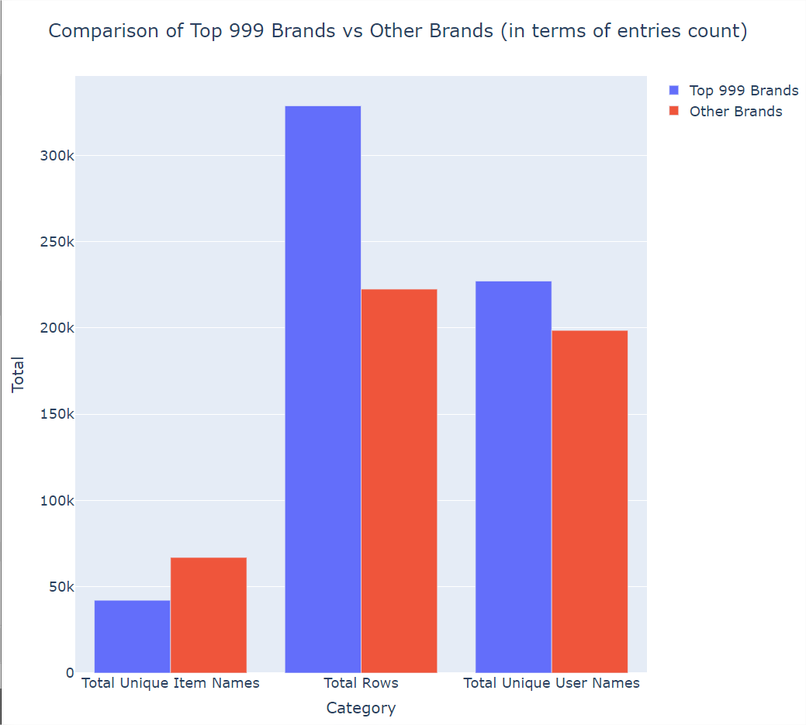

Slide 11
Exploration - Missing values
price: About 20.3% missing. Given its potential impact on product ratings, we might consider filling missing values with the median price, assuming the data's distribution might be skewed. brand, reviewText, summary, category, rating, reviewTime, vote, description, image, feature: These columns have varying degrees of missing data, ranging from approximately 7% to 8%. itemName, verified, userName: Also have missing values but to a lesser extent.

Slide 12
Data Preparation - Missing values
For price: Fill missing values with the median price, as prices can be heavily skewed by a few very expensive or very cheap products. For rating: Since rating is our target variable, rows with missing ratings might need to be removed, as predicting these without actual ratings could introduce bias. For other columns with textual data (brand, reviewText, summary, description, feature): We might fill missing textual data with a placeholder value like "unknown" or remove rows with missing values depending on their importance to the model and the amount of missing data. For categorical columns (category, verified): Missing values can be filled with a placeholder like "unknown" or the most common category, depending on the column's nature.

Slide 13
Columns: userName, verified, itemName, description, image, brand, feature, category, price, rating, reviewTime, summary, reviewText, and vote.
Data Types: Columns like verified are stored as strings representing Boolean values (e.g., 'TRUE’),
price is a numerical-continuous string that includes a dollar sign,
rating is numerical-descrete field.
The description, feature, summary, and reviewText columns contain text that might require processing for analysis.
Brand contains text
category
username, itemName, reviewTime

Slide 14
Hypotheses
Maybe unverified users can be bots and they should be removed. More analysis on their behavior is required
Vote may increase the comment – maybe double the row

Slide 15
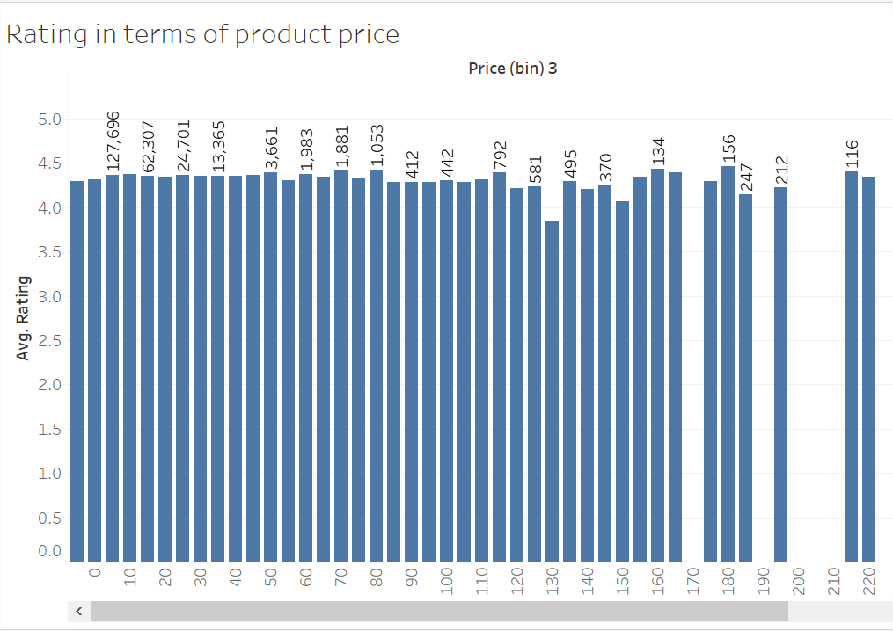

Slide 16
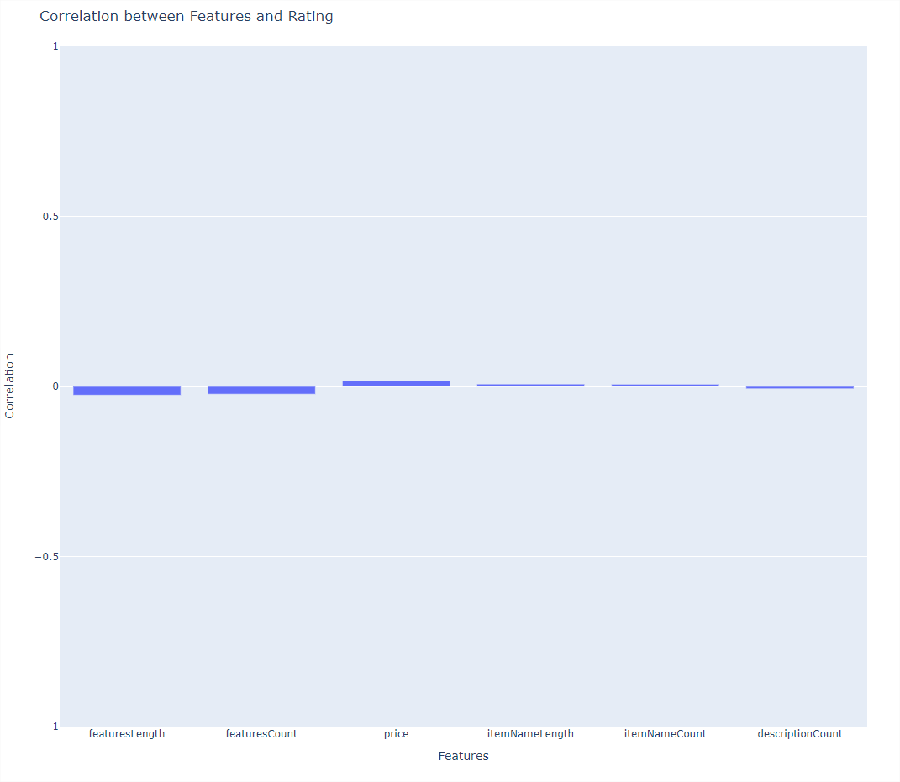
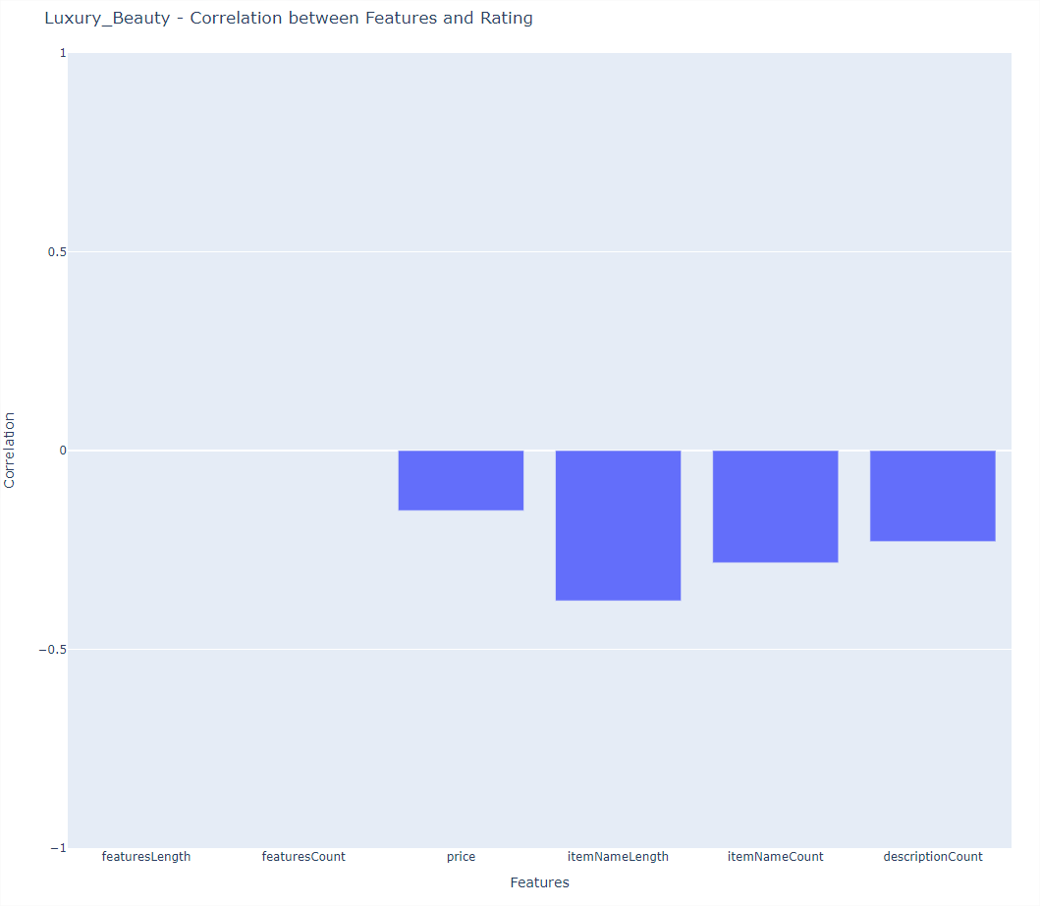
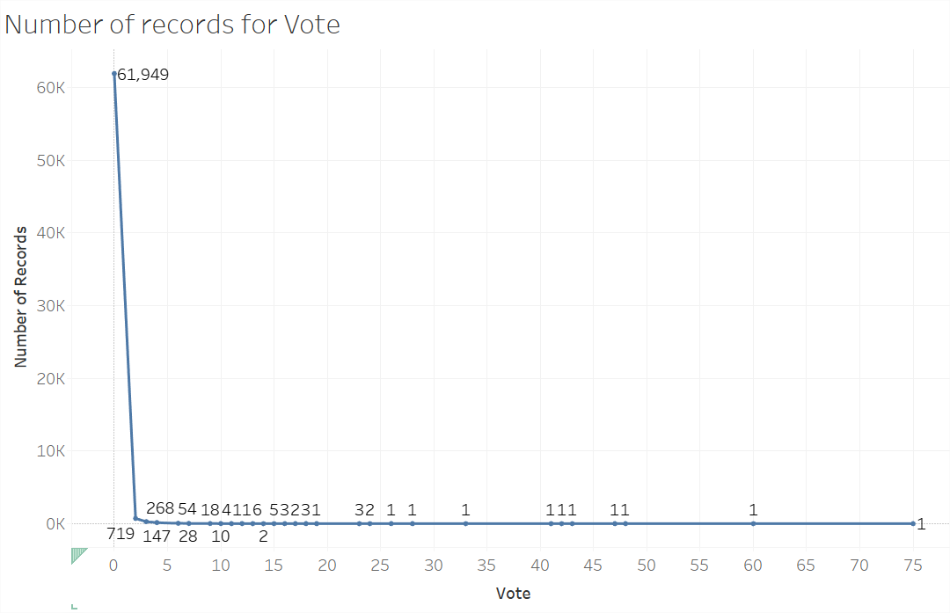
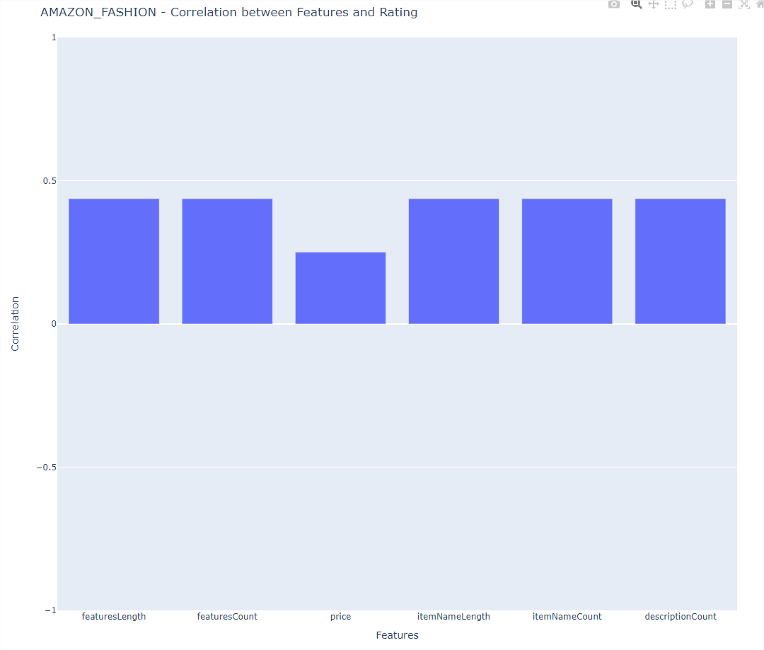

Slide 17
Evaluation
Check whether it’s best to fill the missing values with median, mean or to remove the columns
Check wehter its better to fill string values with “unknown” or “”

